Slide 1
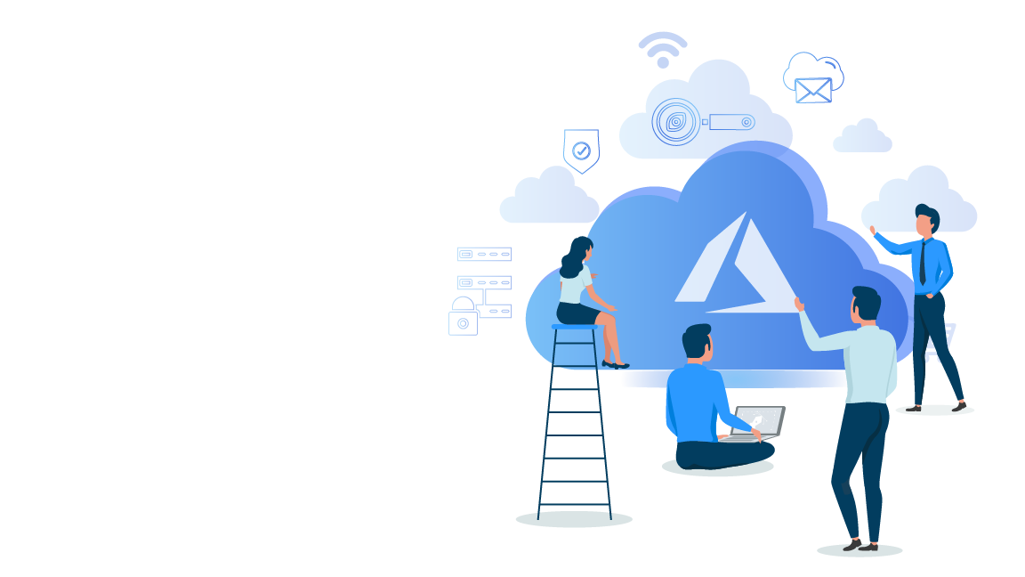


Microsoft Azure Administrator Associate Training(AZ-103)
Module 6

Slide 2
Agenda
01
Identity And Access Management in Azure
02
What is Access management?
03
Role based Access Control
04
Hands-on: Create a Custom Role
05
Role Assignment
06
Hands-On: Assigning Roles
07
What is Azure Active Directory?
08
Windows AD Vs. Azure AD
09
What is Service Audience?
10
Terminologies in Azure Active Directory
Hands-On: Add or Delete Users
12
Hands-On: Create groups and add members
11

Slide 3
Agenda
13
Hands-On: Adding a Custom domain
14
Identity Solution for Hybrid Environments
15
What is Azure AD Connect?
16
Features of Azure AD Connect
17
Self Service Password Reset
18
Hands-On: Enable self service password reset
19
Multi-factor Authentication
20
Quiz

Slide 4
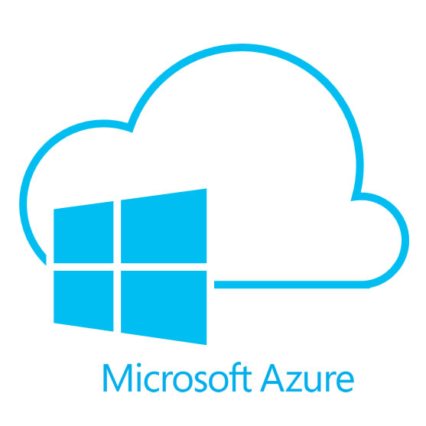
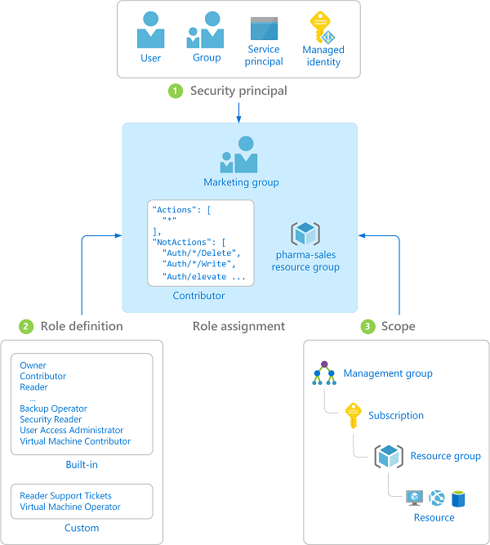


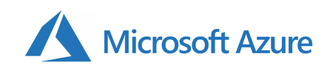
Identity And Access Management in Azure
Azure not only offers identity and access management for Azure cloud but also for hybrid environments.
Identity and Access management
RBAC
Access Control
Identity management
Active Directory
Notes:
Identity and Access management is the heart of any Azure based infrastructure. Understanding and implementing IAM in an appropriate way can help orgniastions keep their data and applications safe from data breaches, account hijacking, ransomware, unauthorized sign ins and other security threats.

Slide 5
What Is Access management in Azure?

Slide 6
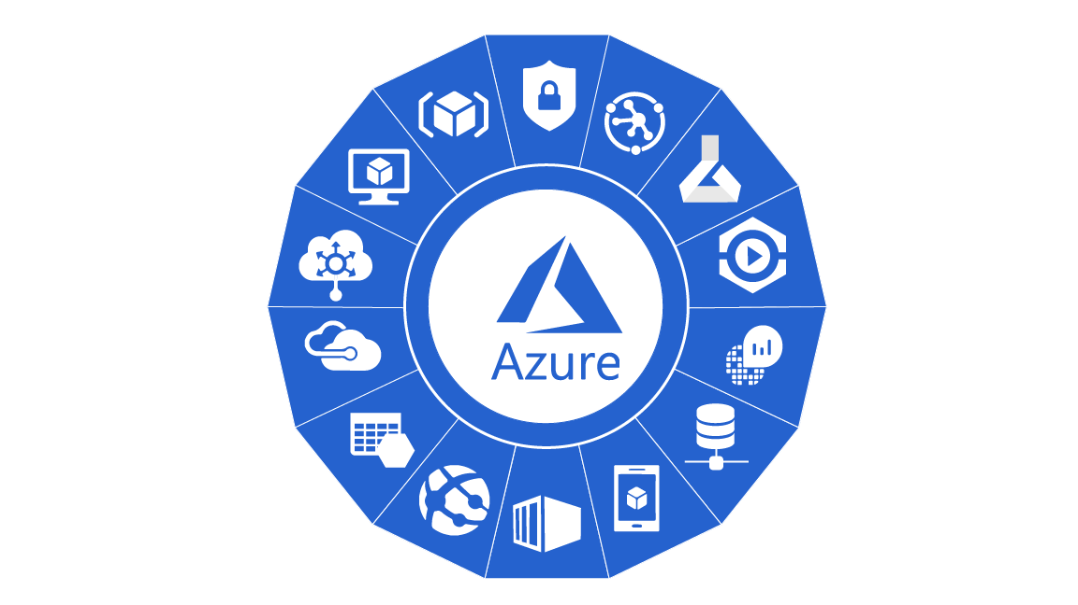


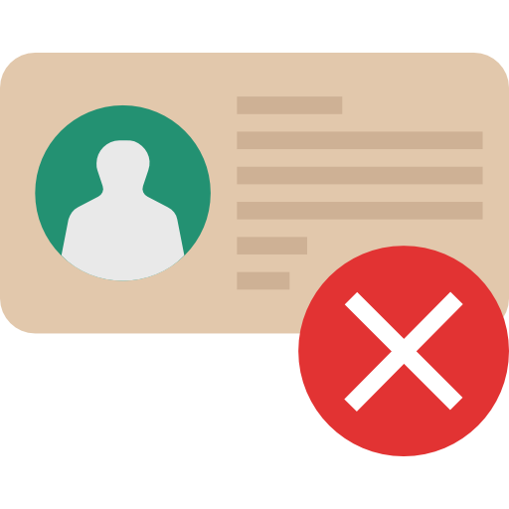
What is Access management in Azure?
Access management in Azure refers to the process that allows, denies or restricts access to Azure services or resources. It also includes, deciding who gets access and up to what extent, in Azure cloud.

Slide 7
Role based Access Control

Slide 8
What is RBAC?
Azure employs role based access control (RBAC) method for access management in Azure cloud. RBAC is used to manage who (user) has access to Azure resources.
RBAC works by creating and assigning roles and then enforcing permissions on those roles. You can use RBAC to:
01
Allow an application to access only a few Azure resources from a resource group.
02
Allow one user to manage only one particular resource in a subscription.
03
Restrict a user from managing only one particular resource in a subscription.

Slide 9
Built-in Roles in Azure
RBAC can be used to create custom roles with permissions of our choice. There are some built-in roles in Azure with pre-defined permissions that can assigned and used.
01
02
03
04
User Access Administrator
Owner
Contributor
Reader
Has full access to all resources including the right to delegate access to others.
Can create and manage all types of Azure resources but can’t grant access to others.
Lets you manage user access to Azure resources.
Can view existing Azure resources.

Slide 10
Built-in Roles in Azure
Apart from these built in roles, Azure also offers some resource specific built-in roles that can be used to perform actions on particular resources and not on other resources.
01
02
03
04
User Access Administrator
Owner
Contributor
Reader
Has full access to all resources including the right to delegate access to others.
Can create and manage all types of Azure resources but can’t grant access to others.
Lets you manage user access to Azure resources.
Can view existing Azure resources.

Slide 11
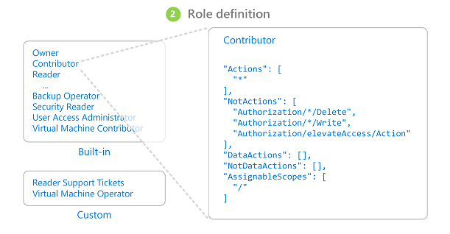
What are Role Definitions?
A role definition is a collection of permissions. A role definition lists the operations that can be performed, such as read, write, and delete. It can also list the operations that can't be performed or operations related to underlying data.

Slide 12

Hands-On: Create a Custom role

Slide 13
Role Assignment
Roles assignment essentially comprises of three elements, namely, security principal, role & role definition and finally a scope.
Security principal
A user, group, service principal or a managed identity that is requesting access to Azure resources is called security principal.
Role Definitions
A set of permissions and operations that can or cannot be performed.
Scope
Role Definitions
Scope
Security principal
Scope is the set of resources that the access is applied to. You can specify a scope at multiple levels, like, management group, subscription, resource group, or resource.

Slide 14
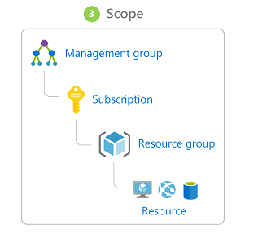
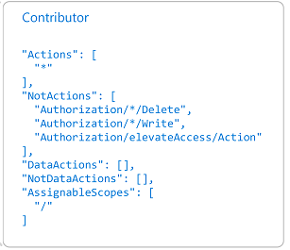
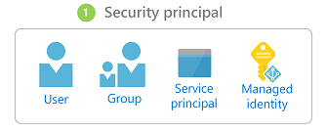
Role Assignment
A role assignment is the process of attaching a role containing a role definition to a user, group, service principal, or managed identity at a particular scope for the purpose of granting access.
Access is granted by creating a role assignment, and access is revoked by removing a role assignment.
Role
G
+
Role Name
Role Definition

Slide 15
Hands-On: Configure access to Azure resources by assigning roles

Slide 16
Identity Management & Azure Active Directory

Slide 17
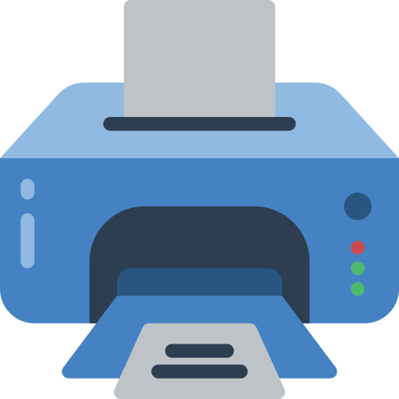




What is Active Directory?
Active directory is used to store and organize information about various elements of an organization’s network such as computers, users, resources like printers, shared files or folders.

Slide 18
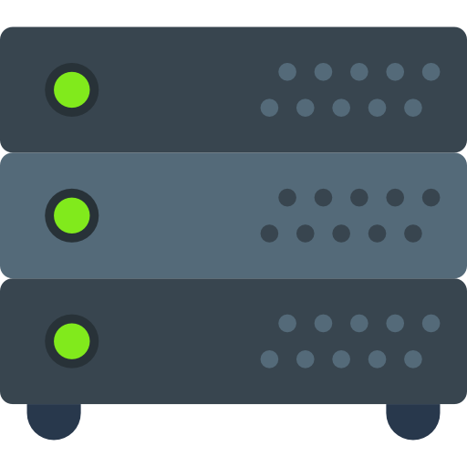
What is Active Directory?
Active directory information can be used to authenticate and authorize the users, computers, resources that are part of the organization's network.
Successfully Authenticated
Authenticate

Slide 19
What is Azure Active Directory?
Azure Active directory (Azure AD) is the identity management solution for Azure. It is a live directory or a database that stores user accounts and their passwords, computers, files shares, security groups, permissions and so much more.
Active Directory

Slide 20
What is Azure Active Directory?
Azure active directory is Microsoft's multi tenant, identity solution for Azure. Azure AD is a one stop solution for core directory services for cloud, application access management and identity authentication.
Active Directory

Slide 21
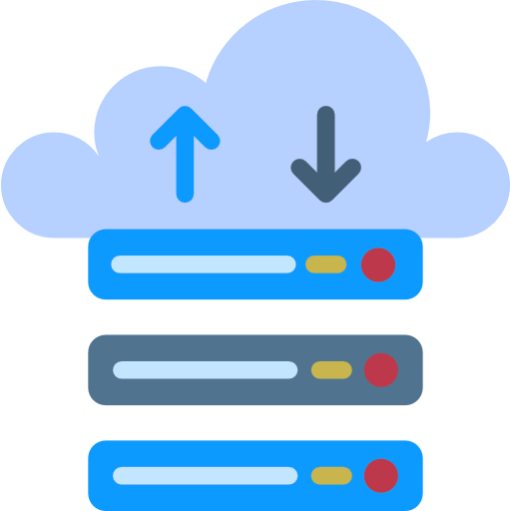
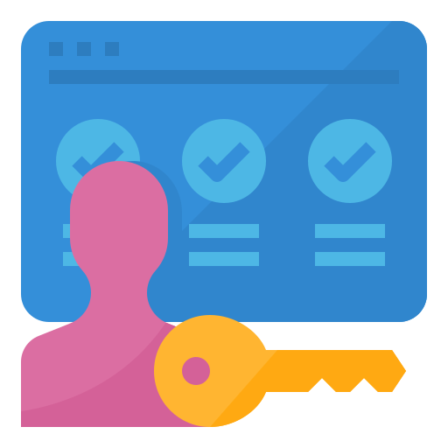

Before Azure Active Directory?
For any service that you might want to use, you are given a set of username and password, using which you can access that particular service for which the username and password is created.
Database Service
Username & password

Slide 22

Before Azure Active Directory?
For any service that you might want to use, you are given a set of username and password, using which you can access that particular service for which the username and password is created.
Database Service
Username & password
Cloud function
Username & password

Slide 23

Before Azure Active Directory?
For any service that you might want to use, you are given a set of username and password, using which you can access that particular service for which the username and password is created.
Database Service
Username & password
Cloud function
Username & password
Azure VM
Username & password

Slide 24


Before Azure Active Directory?
For any service that you might want to use, you are given a set of username and password, using which you can access that particular service for which the username and password is created.
Database Service
Username & password
Cloud function
Username & password
Azure VM
Username & password
Employee
Admin

Slide 25
After Azure Active Directory?
For any service that you might want to use, you are given a single set of username and password, using which you can access any service that you want, as long as the admin has given you the permission.
Azure Active directory provides single sign on feature
Database Service
Cloud function
Username & password
Employee
Azure VM
Admin

Slide 26
Windows AD Vs. Azure AD

Slide 27
What is Windows Active Directory?
Windows Active directory is a windows OS directory service that offers a single interface for organizing and maintaining information about the organization's network.
Windows Active directory works on different layers. Each layer to perform different tasks
ADDS (Windows Active Directory Domain Services)
ADRMS(Active Directory Rights Management Services)
ADFC (Active Directory Federation Services)
2
4
1
3
5
ADLS (Azure Data Lake Storage Services)
ADCS(Active Directory and Certification Services)

Slide 28
What is Windows Active Directory?
Windows Active directory works on different layers. Each layer to perform different tasks
ADDS (Windows Active Directory Domain Services)
ADRMS(Active Directory Rights Management Services)
ADFC (Active Directory Federation Services)
2
4
1
3
5
ADLS (Azure Data Lake Storage Services)
ADCS(Active Directory and Certification Services)
This layer allows admins to manage and monitor the information related to user logins.

Slide 29
What is Windows Active Directory?
Windows Active directory works on different layers. Each layer to perform different tasks
ADDS (Windows Active Directory Domain Services)
ADRMS(Active Directory Rights Management Services)
ADFC (Active Directory Federation Services)
2
4
1
3
5
ADLS (Azure Data Lake Storage Services)
ADCS(Active Directory and Certification Services)
This layer allows the admin the store any amount of data of any type and size.

Slide 30
What is Windows Active Directory?
Windows Active directory works on different layers. Each layer to perform different tasks
ADDS (Windows Active Directory Domain Services)
ADRMS(Active Directory Rights Management Services)
ADFC (Active Directory Federation Services)
2
4
1
3
5
ADLS (Azure Data Lake Storage Services)
ADCS(Active Directory and Certification Services)
ADFS layer allows you to have single sign-on access to systems and applications within the organization's network.

Slide 31
What is Windows Active Directory?
Windows Active directory works on different layers. Each layer to perform different tasks
ADDS (Windows Active Directory Domain Services)
ADRMS(Active Directory Rights Management Services)
ADFC (Active Directory Federation Services)
2
4
1
3
5
ADLS (Azure Data Lake Storage Services)
ADCS(Active Directory and Certification Services)
This layers enables admins to customize services in order to issue and manage public certificates

Slide 32
What is Windows Active Directory?
Windows Active directory works on different layers. Each layer to perform different tasks
ADDS (Windows Active Directory Domain Services)
ADRMS(Active Directory Rights Management Services)
ADFC (Active Directory Federation Services)
2
4
1
3
5
ADLS (Azure Data Lake Storage Services)
ADCS(Active Directory and Certification Services)
ADRMS layer is used for data protection.

Slide 33
Windows AD Vs. Azure AD
Azure Active directory merged all these layers into just two layers.
ADDS (Windows Active Directory Domain Services)
ADRMS(Active Directory Rights Management Services)
ADFC (Active Directory Federation Services)
2
4
1
3
5
ADLS (Azure Data Lake Storage Services)
ADCS(Active Directory and Certification Services)

Slide 34
Windows AD Vs. Azure AD
Azure Active directory merged all these layers into just two layers.
WAAD (Windows Azure Active Directory)
1
2
WAAC (Windows Azure Access Control Service)
1
3

Slide 35
Service Audience

Slide 36




Service Audience
IT Administrator
Application Developer
Online Customers
IT administrator will be responsible for all sign-ups and sign-ins.
Provide relevant authentication and permissions to customers or users
Resolve authentication issues
Online customers can access services such as office 365 and other CRM services with their Azure active directory credentials.
Developers get easy and hassle free access to the relevant services to develop applications

Slide 37
Terminologies in Azure Active Directory

Slide 38




Terminologies in Azure Active Directory
g
DMAINS
GROUPS
TENANTS
USER
TENANTS
DOMAINS
USER
GROUPS
Tenant is an organization.
Microsoft ensures that all the tenants or the organizations using Microsoft Cloud services stay isolated and separated, in order to maintain their services separately.
A domain is a DNS zone for which the tenant has proven ownership. Each tenant has a core domain (onmicrosoft.com)
Users are the individuals that are given permission and set of username and password to access and use certain services
Groups are the logical group of users. Groups are created to organize the users or devices on the basis of geographic location, department, types of services or hardware characteristics.

Slide 39
Terminologies in Azure Active Directory
g
DMAINS
GROUPS
TENANTS
USER
TENANTS
DOMAINS
USER
GROUPS
Tenant is an organization.
Microsoft ensures that all the tenants or the organizations using Microsoft Cloud services stay isolated and separated, in order to maintain their services separately.
A domain is a DNS zone for which the tenant has proven ownership. Each tenant has a core domain (onmicrosoft.com)
Users are the individuals that are given permission and set of username and password to access and use certain services
Groups are the logical group of users. Groups are created to organize the users or devices on the basis of geographic location, department, types of services or hardware characteristics.

Slide 40
Hands-On: Add a Custom Domain in Azure Active Directory

Slide 41
Terminologies in Azure Active Directory
g
DMAINS
GROUPS
TENANTS
USER
TENANTS
DOMAINS
USER
GROUPS
Tenant is an organization.
Microsoft ensures that all the tenants or the organizations using Microsoft Cloud services stay isolated and separated, in order to maintain their services separately.
A domain is a DNS zone for which the tenant has proven ownership. Each tenant has a core domain (onmicrosoft.com)
Users are the individuals that are given permission and set of username and password to access and use certain services
Groups are the logical group of users. Groups are created to organize the users or devices on the basis of geographic location, department, types of services or hardware characteristics.

Slide 42
Hands-On: Add or Delete Users using Azure Active Directory

Slide 43
Terminologies in Azure Active Directory
g
DMAINS
GROUPS
TENANTS
USER
TENANTS
DOMAINS
USER
GROUPS
Tenant is an organization.
Microsoft ensures that all the tenants or the organizations using Microsoft Cloud services stay isolated and separated, in order to maintain their services separately.
A domain is a DNS zone for which the tenant has proven ownership. Each tenant has a core domain (onmicrosoft.com)
Users are the individuals that are given permission and set of username and password to access and use certain services
Groups are the logical group of users. Groups are created to organize the users or devices on the basis of geographic location, department, types of services or hardware characteristics.

Slide 44
Hands-On: Create groups and Add members using Azure Active Directory

Slide 45
Identity Solution for Hybrid Environments

Slide 46
What is Azure AD Connect?

Slide 47

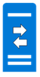
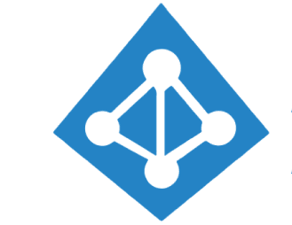

What is Azure AD Connect?
Azure AD Connect is the bridge solution offered by Azure for an organization's on premise Active Directory or identity infrastructure and cloud based Azure Active Directory.
On-premise identity Infrastructure
Azure Active Directory Connect
Azure Active Directory

Slide 48
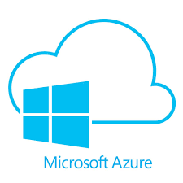
What is Azure AD Connect?
Azure AD Connect is the bridge solution offered by Azure for an organization's on premise Active Directory or identity infrastructure and cloud based Azure Active Directory.
On-premise services
Username & password
Azure Cloud Services

Slide 49
Features of Azure Active Directory Connect

Slide 50
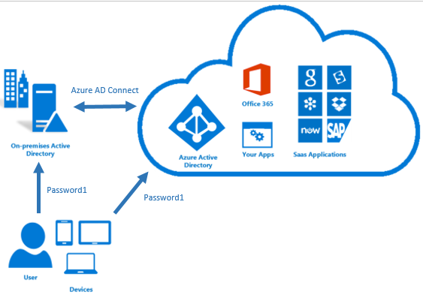
Features of Azure Active Directory Connect
Password hash synchronization
One of the sign-in methods used to accomplish hybrid identity. Azure AD Connect synchronizes a hash, of the hash, of a users password from an on-premises Active Directory instance to a cloud-based Azure AD instance.
Pass-through authentication
Federation integration
Synchronization
Health Monitoring

Slide 51
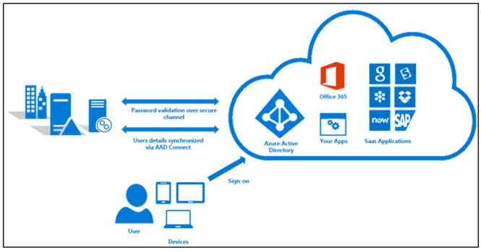
Features of Azure Active Directory Connect
Password hash synchronization
Pass-through Authentication allows your users to sign in to both on-premises and cloud-based applications using the same passwords.
Pass-through authentication
Federation integration
Synchronization
Health Monitoring

Slide 52
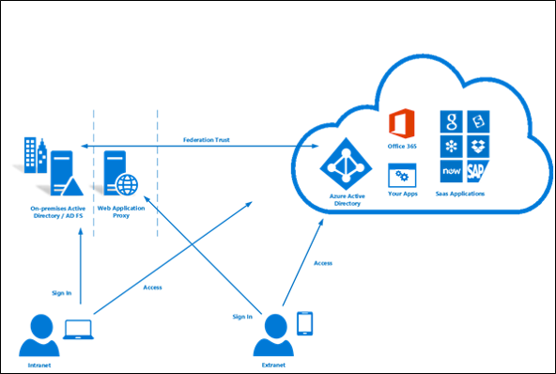
Features of Azure Active Directory Connect
Password hash synchronization
Federation is an optional part of Azure AD Connect and can be used to configure a hybrid environment using an on-premises AD FS infrastructure.
Pass-through authentication
Federation integration
Synchronization
Health Monitoring

Slide 53

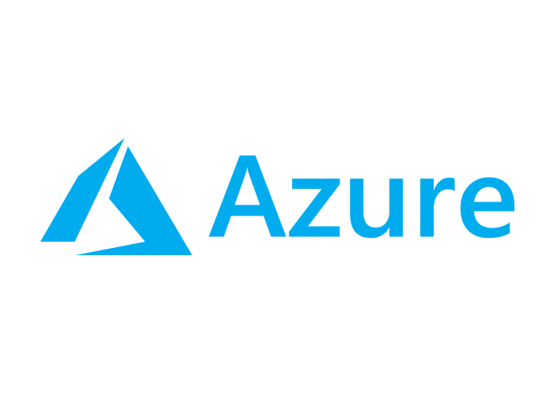
Features of Azure Active Directory Connect
Password hash synchronization
Responsible for creating users, groups, and other objects. As well as, making sure identity information for your on-premises users and groups is matching the cloud. This synchronization also includes password hashes.
Pass-through authentication
Federation integration
Synchronization
Health Monitoring

Slide 54
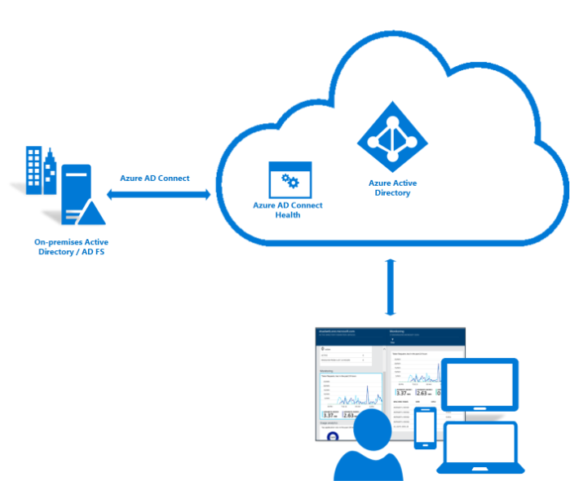
Features of Azure Active Directory Connect
Password hash synchronization
Azure AD Connect Health can provide robust monitoring and provide a central location in the Azure portal to view this activity.
Pass-through authentication
Federation integration
Synchronization
Health Monitoring

Slide 55
Implementing Authentication in Azure
Self Service password Reset
Multi-factor Authentication

Slide 56
What is Self Service Password Reset

Slide 57

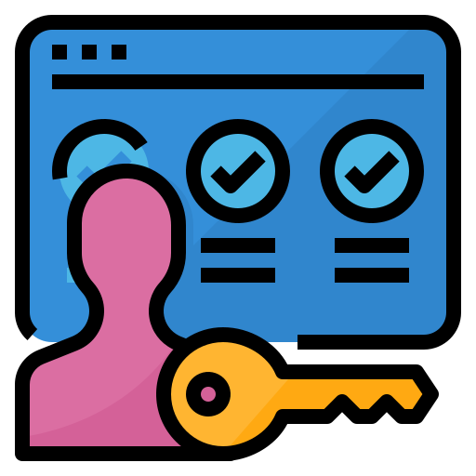
Self Service Password Reset
Self Service password reset(SSPR) offers a means for IT Admins to enable the users to reset or unlock their own passwords or accounts without any IT intervention.
If SSPR is enabled, you must select at least one of the following options/Gates for the authentication methods.
01
Mobile phone
02
Mobile app notification
03
Office phone
04
Email
05
Security questions
06
Mobile app code

Slide 58
Why Self Service Password Reset?

Slide 59




Why Self-Service Password Reset?
Reduces helpdesk Call Volumes and expedites the password reset procedure
Ensures that password problems are only resolved after adequate user authentication
Eliminates the drawback of many help desks, that is intruder attack to claim a new password
Helps users set a password of their own convenience, which later helps them remember their password easily

Slide 60
Hands on: Enable Self Service Password Reset

Slide 61
Multi-factor Authentication

Slide 62


What is Multi-factor Authentication?
Multi factor Authentication combines multiple number of independent credentials to create a layered defense against unauthorized authentication or unauthorized access.
For example, it might use the combination of following credentials:
what the user knows, that is password
what the user has, that is security token on a trusted device
what the user is, that is biometric verification
Username
Password

Slide 63
Quiz

Slide 64

Quiz
1. What is Azure Active Directory?
A. Networking Service offered by Azure
B. Data Warehouse Service offered by Azure
B. Identity and Access management service offered by Azure
D. Another term for Azure subscription

Slide 65
Quiz
2. Which of the following tasks cannot be performed using rbac in Azure?
A. Grant access to an application to access some selected Azure resources from a resource group
B. Grant access to a user to access the whole resource group
B. Restrict a user from accessing the whole subscription
D. None of the above

Slide 66
Quiz
3. Self service password reset feature lets users login without using any authentication credentials. True or False?
A. True
B. False

Slide 67
Quiz
4. Which is the following statements in false?
A. Azure uses Rbac method for access management
B. There can only be one Azure Active directory per account
B. IAM services offered by Azure can only be used on Azure cloud environment and cannot be extended on hybrid environment
D. Azure Active Directory helps achieving SSO

Slide 68
Quiz
5. Multiple subscriptions can trust the same Azure AD directory, but each subscription can only trust a single directory.
A. True
B. False

Slide 69
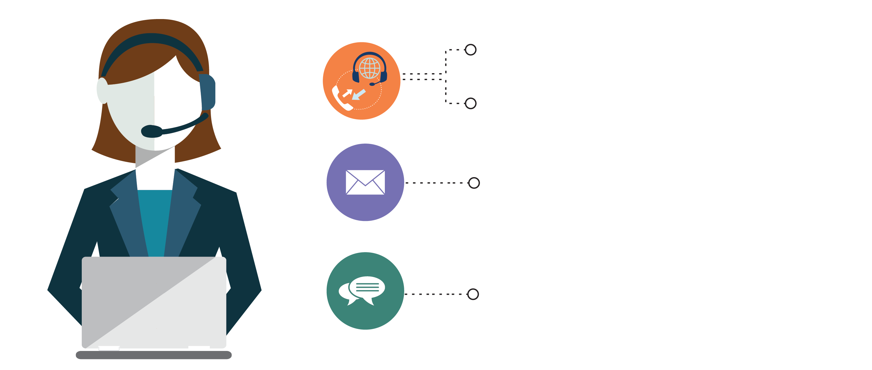
India: +91-7847955955
US: 1-800-216-8930 (TOLL FREE)
support@intellipaat.com
24/7 Chat with Our Course Advisor
Notes:
Thank you!

